Slide 1
Algorithmic Maze Solving
Advanced Algorithms
SIUE Department of Computer Science
Gwyneth Cross and Kalab Depew

Slide 2
Big Problem

Slide 3
Maze Solving
Pathfinding algorithms are an important algorithmic concept
Used in many applications (ex. Video games, navigation)
Mazes are a good randomly-generatable puzzle for pathfinding algorithms to solve
Mazes are also a controlled space in which to test the efficiency of the algorithms

Slide 4
Methodology
I

Slide 5
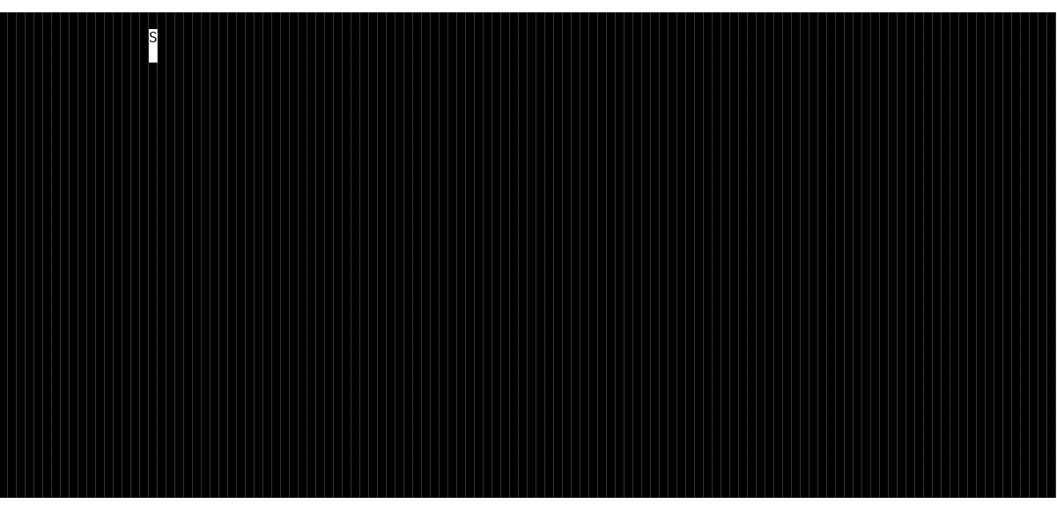
Dataset: Making the Mazes

Slide 6
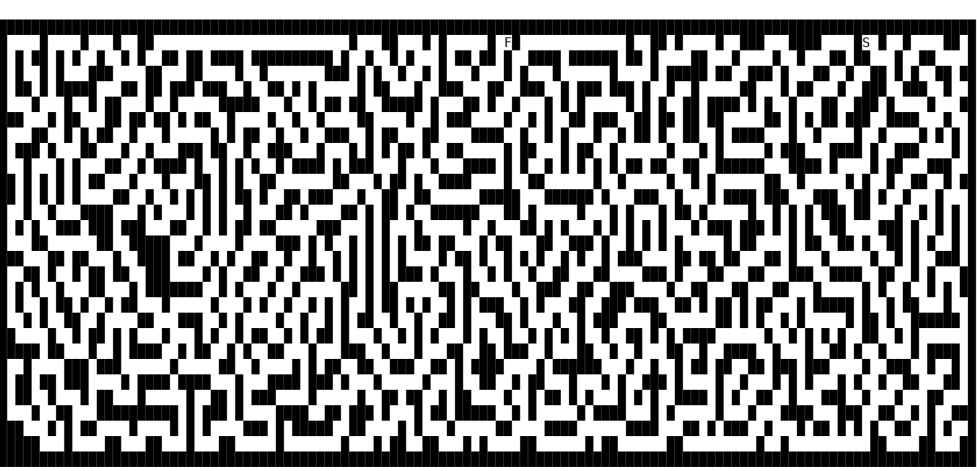
Dijkstra's (Greedy)
Dijkstra's (Greedy)

Slide 7
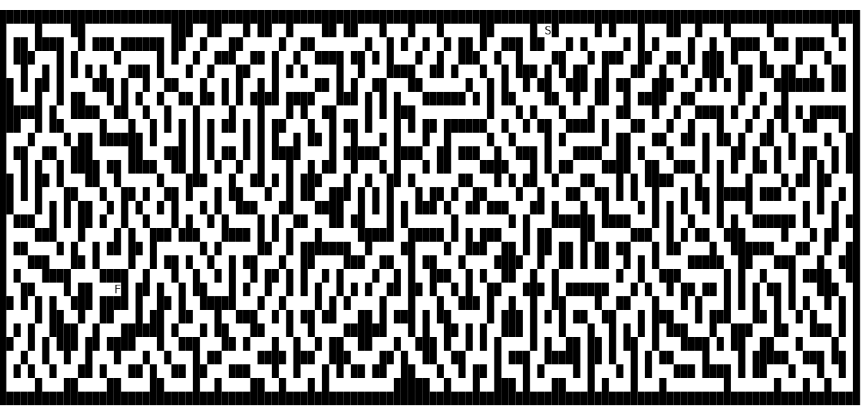
DFS
BFS and DFS (benchmark)

Slide 8
Path Counting (Dynamic)
Have not implemented yet
Should output number of paths found
Should also output visual to represent each path found

Slide 9
Experiment Design

Slide 10
Comparing efficiency
Running time and Nodes visited data were collected for Dijkstra's, BFS, and DFS
Time was calculated using the high resolution timer from the chrono library
Each algorithm was tested for mazes from size 10x10 to 100x100

Slide 11
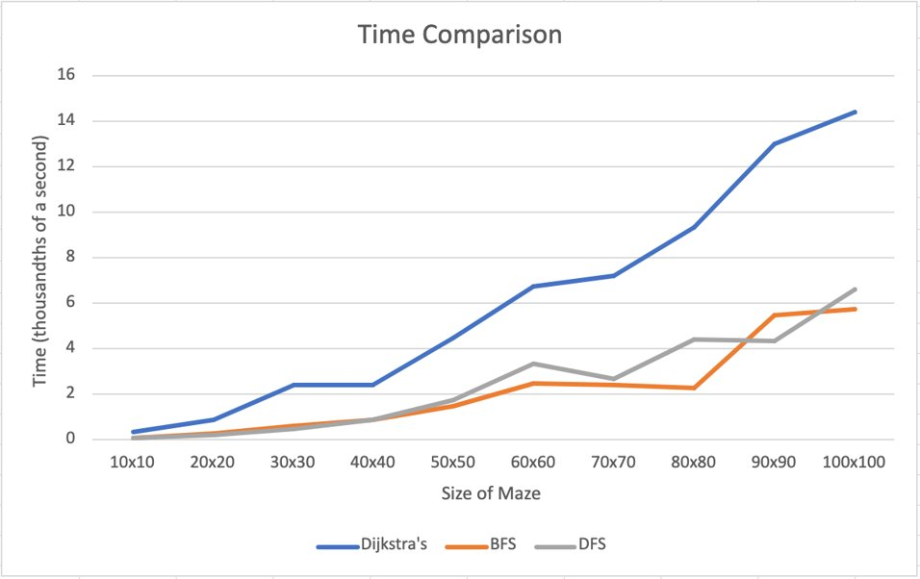

Slide 12
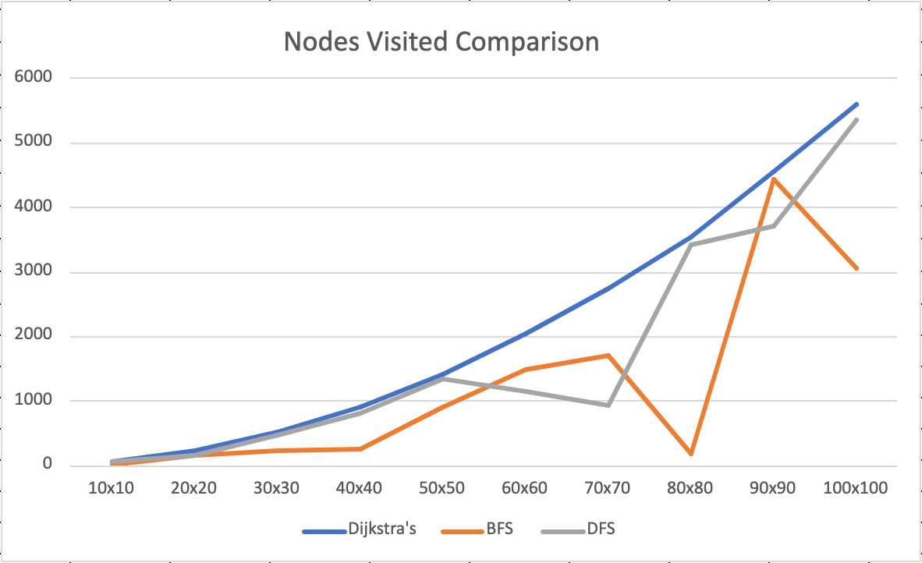

Slide 13
Analysis and Discussion

Slide 14
Results
Dijkstra's was the most consistent algorithm, with time complexity increasing as maze size increases
DFS took the least time to solve the maze on average and had the least consistent number of nodes visited
BFS was consistently mediocre (between Dijkstra's and DFS)
It's possible for DFS and BFS to get "lucky" with a maze generation and solve it quickly
Dijkstra's cannot get "lucky" as it must visit every possible location before finding an answer

Slide 15
Weaknesses
Current methods of measuring efficiency don't showcase Dijkstra's strength: finding the best path
"luckiness" of DFS and BFS may make them less useful as benchmarks

Slide 16
Conclusion

Slide 17
Results so Far
We successfully implemented a maze generator
Dijkstra's and benchmark BFS and DFS work correctly
Results show that Dijkstra's is consistent
More work to be done on Path Counting
Implement an additional efficiency metric to capture Dijkstra's strengths

Slide 18
Future Work
Complete implementation of Path Counting
Implement a divide and conquer algorithm (Christophid's? Nearest Neighbor?) and test its efficiency

Slide 19
Thank you!
Questions?

Slide 21
Solution Algorithm
Dijkstra's
Maze Algorithm
Path Counting
User Input
(N rows, M columns)
Maze Generation
Convert to Weighted Graph
BFS/DFS

